Slide 1
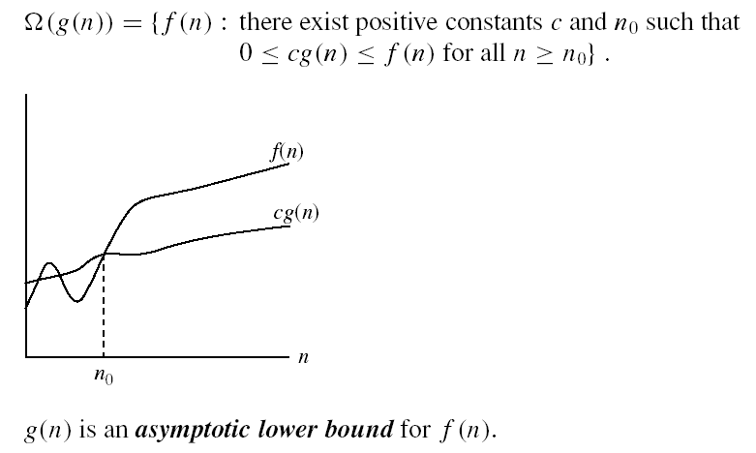
Asymptotic notations (cont.)
Ω - notation
Ω(g(n)) is the set of functions with larger or same order of growth as g(n)

Slide 2
Examples
  5n² = Ω(n)
  n = Ω(2n)
  n³ = Ω(n²)
  n = Ω(logn)
  There exis some c, n₀ such that: 0 ≤ cn ≤ 5n²
⇒ cn ≤ 5n²
⇒ c = 1 and n₀ = 1

Slide 3


Asymptotic notations (cont.)
Θ-notation
Θ(g(n)) is the set of functions with the same order of growth as g(n)

Slide 4
Relations Between Different Sets
Subset relations between order-of-growth sets.
O( f )
Ω( f )
• f
Θ( f )

Slide 5
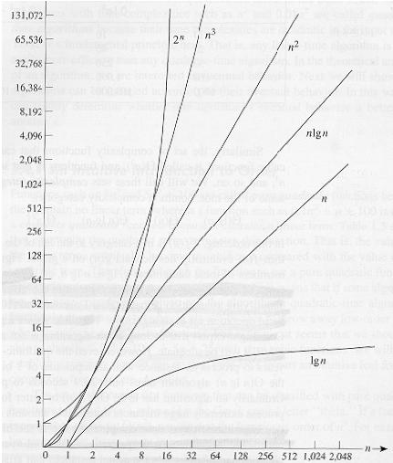
Common orders of magnitude

Slide 6
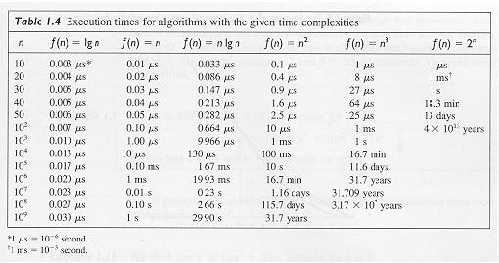
Common orders of magnitude

Slide 7
Exercise
For each of the following pairs of functions, either f(n) is O(g(n)), f(n) is Ω(g(n)), or f(n) = Θ(g(n)). Determine which relationship is best fit.
  f(n) = log n²; g(n) = log n + 5
  f(n) = n; g(n) = log n²
  f(n) = log log n; g(n) = log n
  f(n) = n; g(n) = log² n
  f(n) = n log n + n; g(n) = log n
  f(n) = 10; g(n) = log 10
  f(n) = 2^{n}; g(n) = 10n²
  f(n) = 2^{n}; g(n) = 3^{n}
f(n) = Θ (g(n))
f(n) = Ω(g(n))
f(n) = O(g(n))
f(n) = Ω(g(n))
f(n) = Ω(g(n))
f(n) = Θ(g(n))
f(n) = Ω(g(n))
f(n) = O(g(n))

Slide 8
Properties
Theorem:
f(n) = Θ(g(n)) ⇔ f = O(g(n)) and f = Ω(g(n))
Transitivity:
  f(n) = Θ(g(n)) and g(n) = Θ(h(n)) ⇒ f(n) = Θ(h(n))
  Same for O and Ω
Reflexivity:
  f(n) = Θ(f(n))
  Same for O and Ω
Symmetry:
  f(n) = Θ(g(n)) if and only if g(n) = Θ(f(n))
Transpose symmetry:
  f(n) = O(g(n)) if and only if g(n) = Ω(f(n))

Slide 9
Binary Search Trees
Tree representation:
  A linked data structure in which each node is an object
Node representation:
  Key field
  Satellite data
  Left: pointer to left child
  Right: pointer to right child
  p: pointer to parent (p [root [T]] = NIL)
Satisfies the binary-search-tree property !!
parent
L
R
key
data
Left child
Right child

Slide 10
Binary Search Tree Property
Binary search tree property:
  If y is in left subtree of x,
    then key [y] ≤ key [x]
  If y is in right subtree of x,
    then key [y] ≥ key [x]
5
3
7
2
5
9

Slide 11
Binary Search Trees
Support many dynamic set operations
  SEARCH, MINIMUM, MAXIMUM, PREDECESSOR, SUCCESSOR, INSERT, DELETE
Running time of basic operations on binary search trees
  On average: Θ(lgn)
    The expected height of the tree is lgn
  In the worst case: Θ(n)
    The tree is a linear chain of n nodes

Slide 12
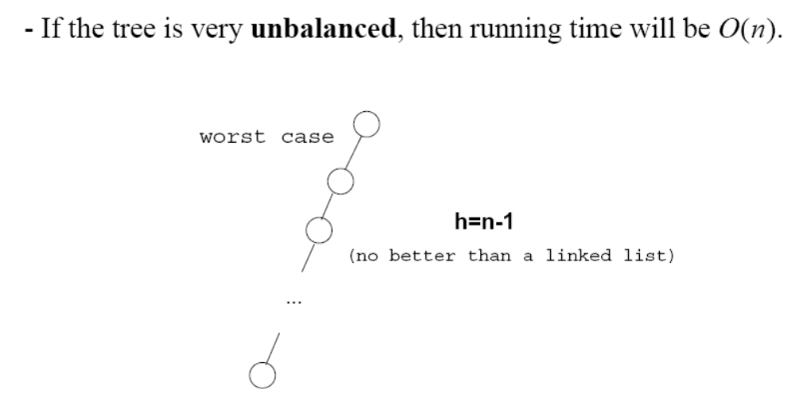
Worst Case
Θ(n)

Slide 13
Traversing a Binary Search Tree
Inorder tree walk:
  Root is printed between the values of its left and right subtrees: left, root, right
  Keys are printed in sorted order
Preorder tree walk:
  root printed first: root, left, right
Postorder tree walk:
  root printed last: left, right, root
Inorder: 2 3 5 5 7 9
5
Preorder: 5 3 2 5 7 9
3
7
Postorder: 2 5 3 9 7 5
2
5
9

Slide 14
Traversing a Binary Search Tree
Alg: INORDER-TREE-WALK(x)
if x ≠ NIL
then INORDER-TREE-WALK ( left [x] )
print key [x]
INORDER-TREE-WALK ( right [x] )
E.g.:
Running time:
  Θ(n), where n is the size of the tree rooted at x
5
Output: 2 3 5 5 7 9
3
7
2
5
9

Slide 15
Searching for a Key
Given a pointer to the root of a tree and a key k:
  Return a pointer to a node with key k
  if one exists
  Otherwise return NIL
Idea
  Starting at the root: trace down a path by comparing k with the key of the current node:
    If the keys are equal: we have found the key
    If k < key[x] search in the left subtree of x
    If k > key[x] search in the right subtree of x
5
3
7
2
4
9

Slide 16
Example: TREE-SEARCH
15
Search for key 13:
  15 → 6 → 7 → 13
6
18
3
7
17
20
2
4
13
9

Slide 17
Finding the Minimum in a Binary Search Tree
Goal: find the minimum value in a BST
  Following left child pointers from the root, until a NIL is encountered
Alg: TREE-MINIMUM(x)
while left [x] ≠ NIL
do x ← left [x]
return x
Running time: O(h), h – height of tree
15
6
18
3
7
17
20
2
4
13
9
Minimum = 2

Slide 18
Finding the Maximum in a Binary Search Tree
Goal: find the maximum value in a BST
  Following right child pointers from the root, until a NIL is encountered
Alg: TREE-MAXIMUM(x)
while right [x] ≠ NIL
do x ← right [x]
return x
Running time: O(h), h – height of tree
15
6
18
3
7
17
20
2
4
13
9
Maximum = 20

Slide 19
Successor
Def: successor (x ) = y, such that key [y] is the smallest key > key [x]
E.g.: successor (15) =
successor (13) =
successor (9) =
Case 1: right (x) is non empty
  successor (x ) = the minimum in right (x)
Case 2: right (x) is empty
  go up the tree until the current node is a left child: successor (x ) is the parent of the current node
  if you cannot go further (and you reached the root): x is the largest element
17
15
15
13
6
18
3
7
17
y
20
x
2
4
13
9

Slide 20
Predecessor
Def: predecessor (x ) = y, such that key [y] is the biggest key < key [x]
E.g.: predecessor (15) =
predecessor (9) =
predecessor (7) =
Case 1: left (x) is non empty
  predecessor (x ) = the maximum in left (x)
Case 2: left (x) is empty
  go up the tree until the current node is a right child: predecessor (x ) is the parent of the current node
  if you cannot go further (and you reached the root): x is the smallest element
13
15
y
7
6
x
18
6
3
7
17
20
2
4
13
9

Slide 21
Insertion
Insert value 13
12
5
18
2
9
15
19
1
3
13
17

Slide 22
Example: TREE-INSERT
Insert 13:
x=root[T], y=NIL
y
12
12
x
5
18
5
18
2
9
15
19
2
9
15
19
1
3
17
1
3
17
12
12
x
y
5
18
5
18
2
9
15
19
2
9
15
19
1
3
17
1
3
13
17
x = NIL
y = 15

Slide 23
Goal:
  Insert value v into a binary search tree
Idea:
  Begining at the root, go down the tree and maintain:
    Pointer x : traces the downward path (current node)
    Pointer y : parent of x (“trailing pointer” )
  If key [x] < v move to the right child of x,
  else move to the left child of x
  When x is NIL, we found the correct position
  If v < key [y] insert the new node as y’s left child
else insert it as y’s right child

Slide 24
Deletion
Goal:
  Delete a given node z from a binary search tree
Idea:
  Case 1: z has no children
    Delete z by making the parent of z point to NIL
15
15
5
16
5
16
3
12
20
3
12
20
z
10
13
18
23
10
18
23
6
delete
6
7
7

Slide 25
Deletion
Case 2: z has one child
  Delete z by making the parent of z point to z’s child, instead of to z
15
delete
15
z
5
16
5
20
3
12
20
3
12
18
23
10
13
18
23
10
6
6
7
7

Slide 26
Deletion
Case 3: z has two children
  Find z’s successor. Let successor be y.
  y has either no children or one right child (but no left child)
  Delete y from the tree (via Case 1 or 2)
  Replace z’s data with y’s.

Slide 27
6
15
15
delete
z
5
16
6
16
3
12
20
3
12
20
10
13
18
23
10
13
18
23
y
6
7
7

Slide 28
Binary Search Trees - Summary
Operations on binary search trees:
  SEARCH O(h)
  PREDECESSOR O(h)
  SUCCESOR O(h)
  MINIMUM O(h)
  MAXIMUM O(h)
  INSERT O(h)
  DELETE O(h)
These operations are fast if the height of the tree is small – otherwise their performance is similar to that of a linked list

Slide 29
Exercise
What is the difference between the MAX-HEAP property and the binary search tree property?
Can the min-heap property be used to print out the keys of an n-node tree in sorted order in O(n) time?
Can you use the heap property to design an efficient algorithm that searches for an item in a binary tree?

